Slide 1
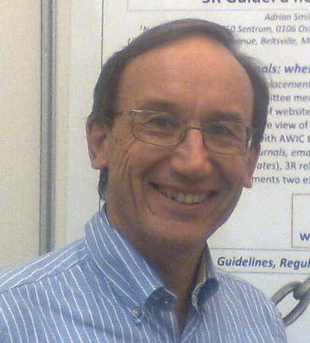

Planning animal research:
PREPARE before you ARRIVE
norecopa.no/PREPARE
Adrian Smith, Eddie Clutton, Elliot Lilley, Kristine Hansen & Trond Brattelid
adrian.smith@norecopa.no
norecopa.no

Slide 2
International consensus meetings
Harmonisation of the Care and Use of:
  Fish (2005)
  Wildlife (2008)
  Fish (2009)
  Agricultural animals (2012)
  Field Research (2017)
https://norecopa.no/meetings
All the presentations are on the internet: a lasting resource

Slide 3
norecopa.no
approx. 7,500 webpages

Slide 4
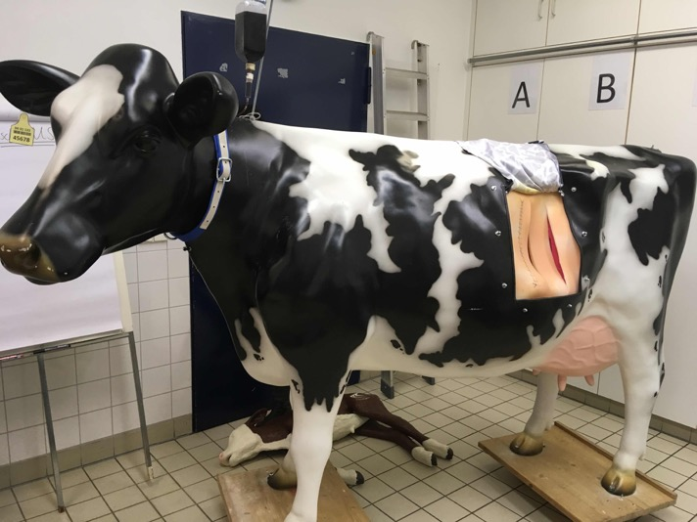
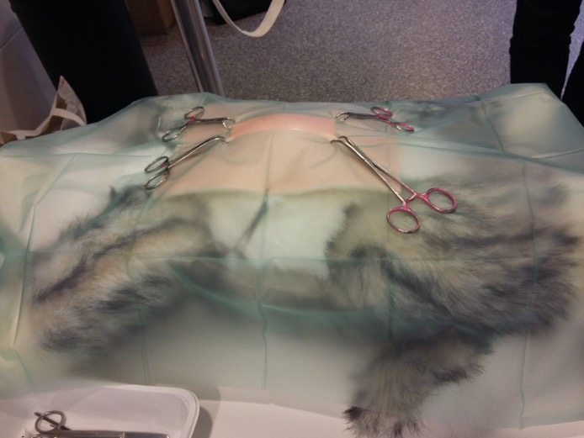
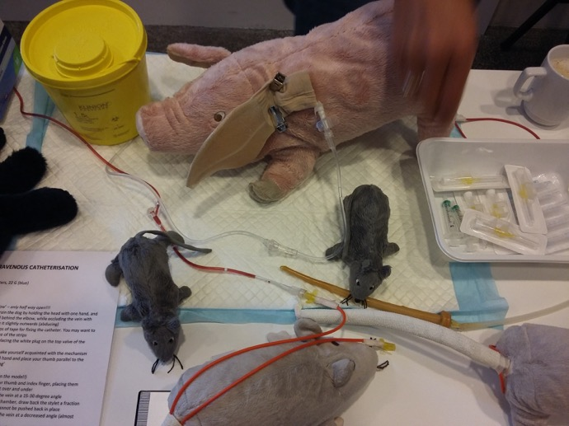
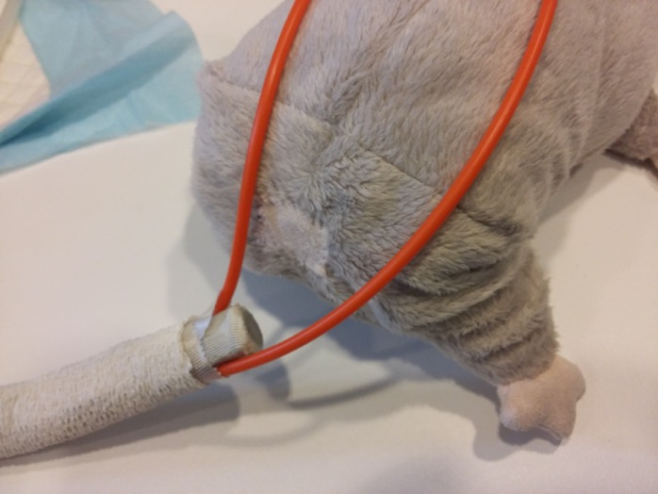
Laura-Kim Schüller, Veterinary School, Berlin
Rikke Langebæk, University of Copenhagen
norecopa.no/education-training/homemade-educational-materials

Slide 5
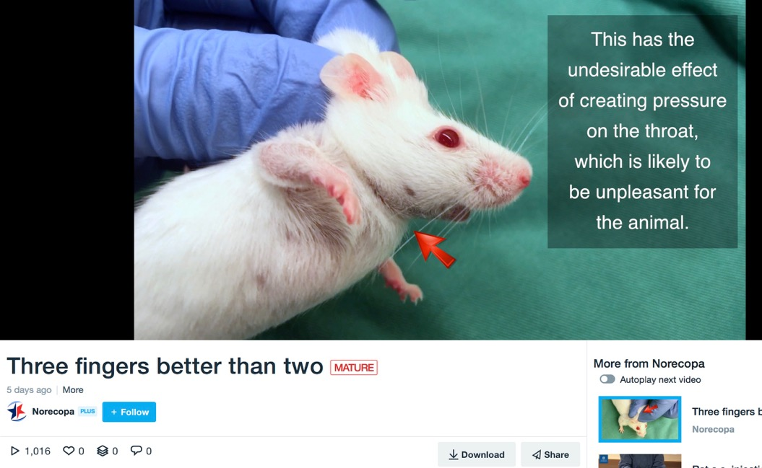
http://bitly.com/scruff-technique

Slide 6
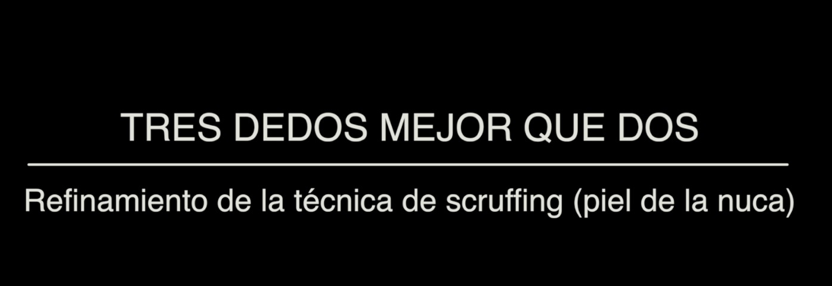
http://bitly.com/scruff-technique

Slide 7
Alice Tillema, Radboud University:
How to construct a literature search
http://norecopa.no/how-to-construct-a-literature-search.pdf

Slide 8

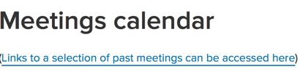
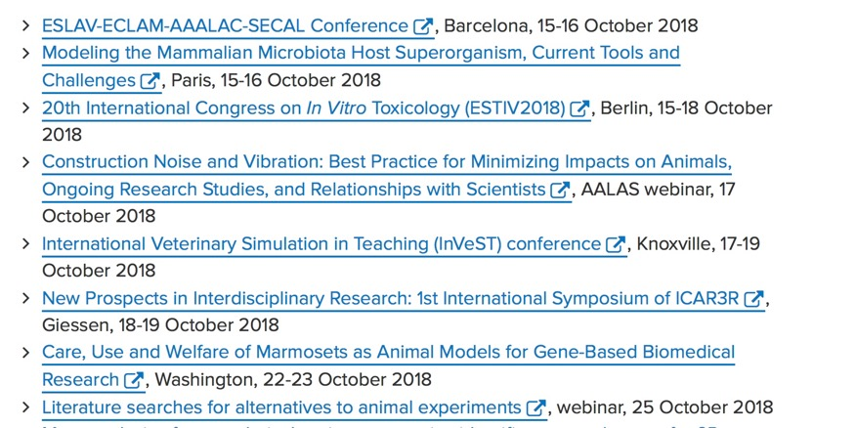

Slide 9


facebook.com/norecopa
@norecopa
Newsletter 7-8 times a year
something for you?

Slide 10
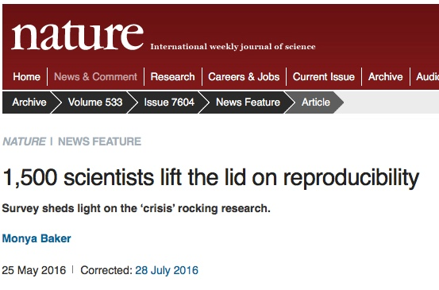
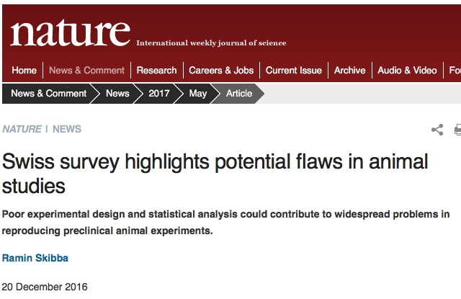
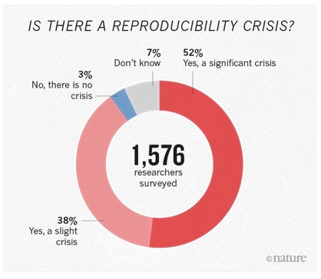
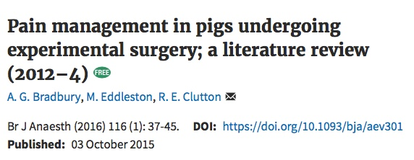
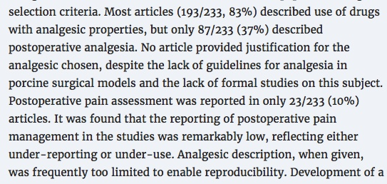
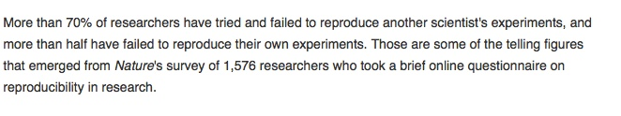

Slide 11
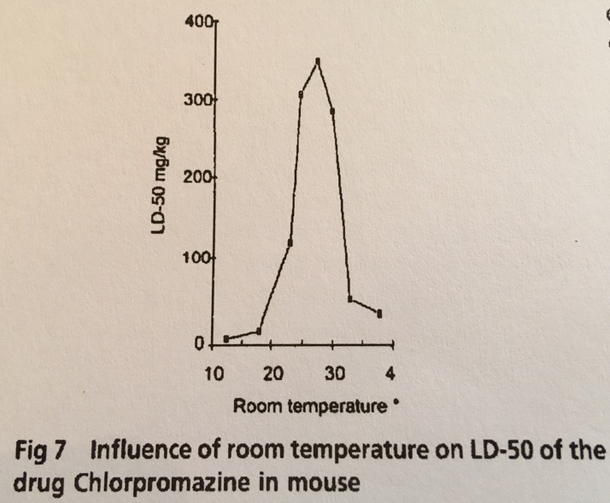
Why is it taking so long to improve reproducibility?
Berti & Cima 1955, quoted in Öbrink and Rehbinder

Slide 12
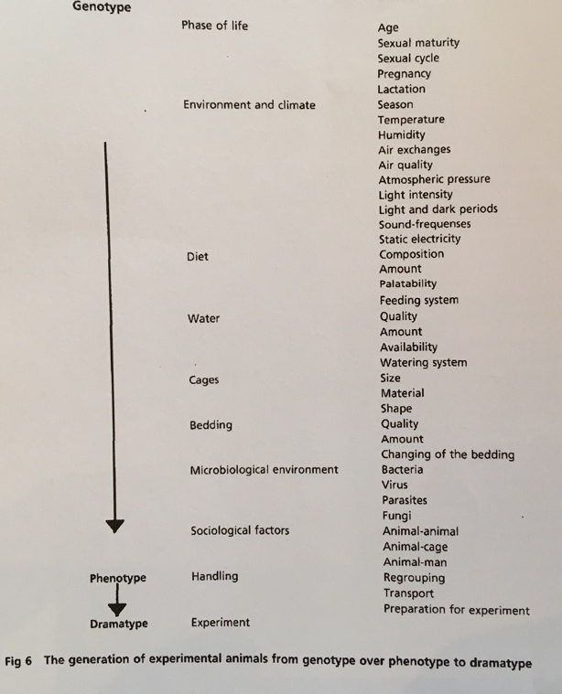
Hurni 1969, quoted in Öbrink and Rehbinder

Slide 13
There is a reproducibility crisis despite the existence of reporting guidelines for over 20 years...
Öbrink & Waller, 1996
Jane Smith et al., 1997
Adrian Smith & Trond Brattelid, 2000 (fish)
Öbrink & Rehbinder: Animal definition: a necessity for the validity of animal experiments? Laboratory Animals, 2000
ARRIVE Guidelines, 2010 (Kilkenny et al., NC3Rs)
Gold Standard Publication Checklist, 2010 (SYRCLE)
Institute for Laboratory Animal Research, NRC, 2011
Instructions to authors, in many journals
  e.g. Nature’s Reporting Checklist

Slide 14
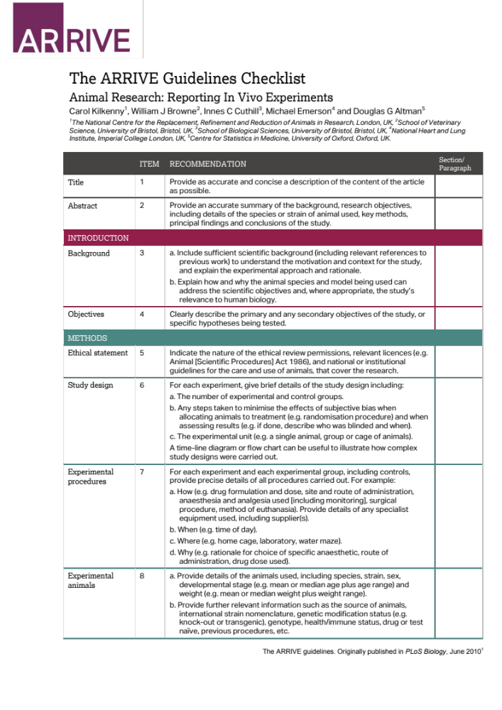
https://www.nc3rs.org.uk/arrive-guidelines

Slide 15
Why do we need to PREPARE when we have ARRIVE?
The ARRIVE guidelines claim that they ‘provide a logical checklist with all the things that need to be considered when designing an experiment’ *
In our experience when planning animal research, a number of additional points need to be addressed at the planning stage.
These items not only improve study quality and animal welfare (and therefore reproducibility), but also the safety of humans and animals affected directly or indirectly by the work.
*http://www.nc3rs.org.uk/sites/default/files/documents/Guidelines/ARRIVE%20Guidelines%20Speaker%20Notes.pdf

Slide 16
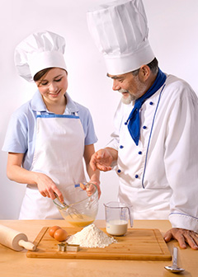
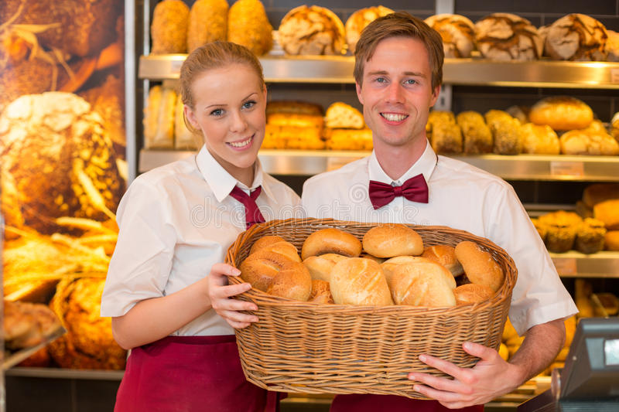
PREPARE
ARRIVE
https://www.bls.gov/ooh/images/3077.jpg
https://www.dreamstime.com

Slide 17
Some of the areas which can be neglected ...
poor literature searches
lack of humane endpoints
poor experimental design
vague distribution of work and costs between the scientists and the animal facility
insufficient evaluation of the facility’s competence and infrastructure
too little attention to transport and acclimation
ignoring health risks for all involved
lack of standard procedures for necropsy
poor planning of waste disposal
little discussion about the fate of the animals

Slide 18
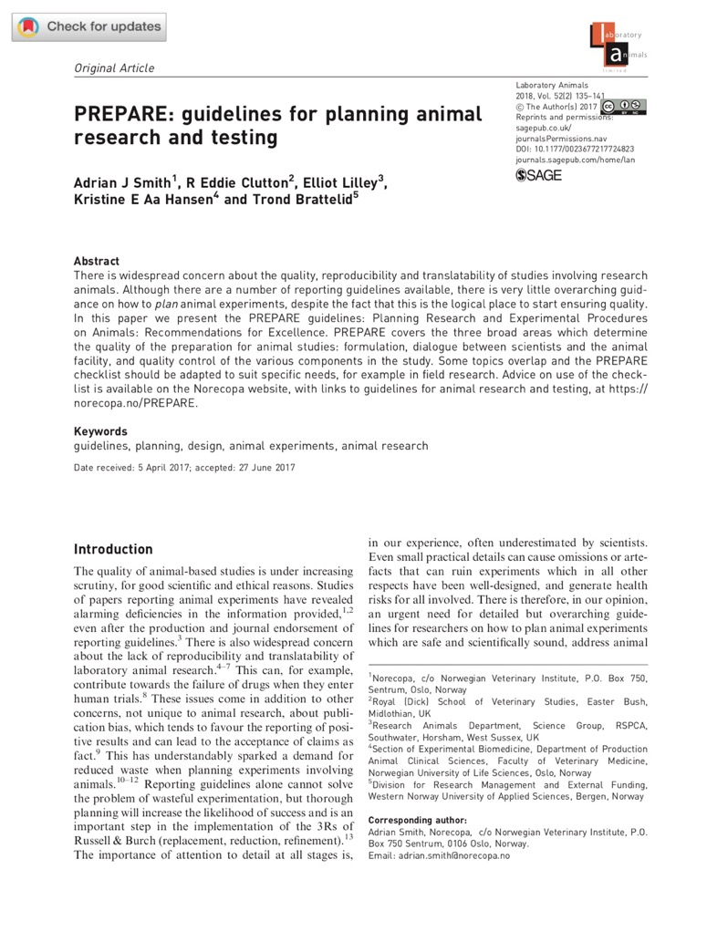

Pre-published under Open Access on 3 August 2017, sponsored by the Universities Federation for Animal Welfare (UFAW), UK
Published in the April 2018 issue of Laboratory Animals
http://journals.sagepub.com/doi/full/10.1177/0023677217724823

Slide 19
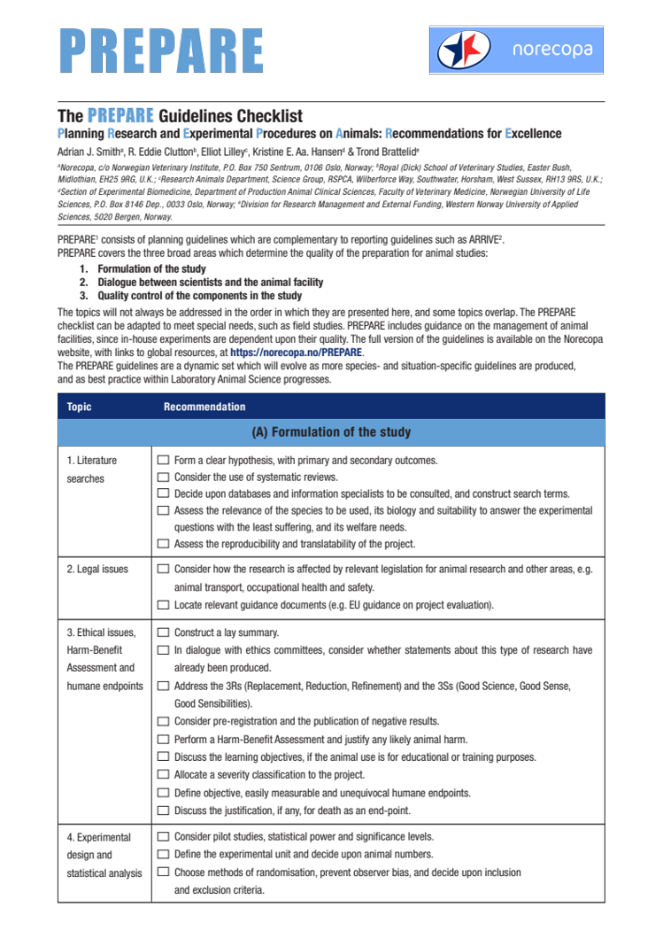
Two pages, translated into 16 languages so far

Slide 20
PREPARE:
Planning Research and Experimental Procedures on Animals: Recommendations for Excellence
PREPARE covers 15 topics:
Formulation of the study
Literature searches
Legal issues
Ethical issues, harm-benefit assessment and humane endpoints
Experimental design and statistical analysis
Dialogue between scientists and the animal facility
Objectives and timescale, funding and division of labour
Facility evaluation
Education and training
Health risks, waste disposal and decontamination
Methods
Test substances and procedures
Experimental animals
Quarantine and health monitoring
Housing and husbandry
Experimental procedures
Humane killing, release, reuse or rehoming
Necropsy
Items in pink are not highlighted in ARRIVE

Slide 21
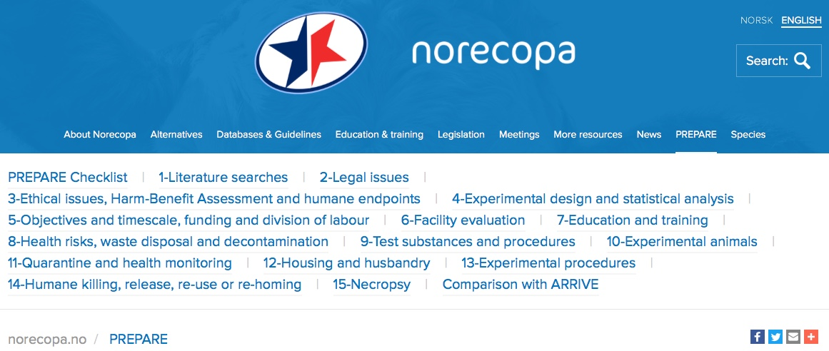
In addition to the checklist, much more information is available on:
norecopa.no/PREPARE

Slide 22
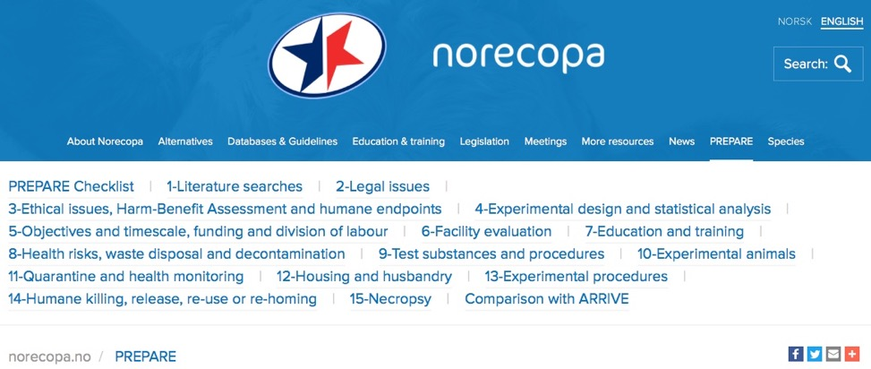
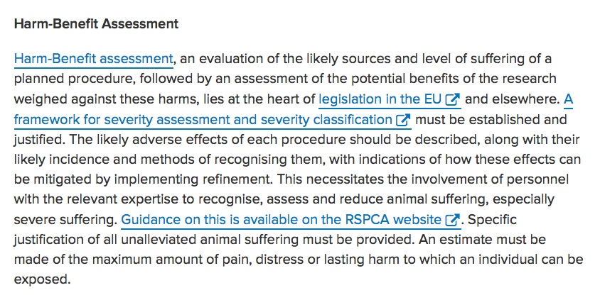
norecopa.no/PREPARE
Links to quality guidelines worldwide on e.g. housing and husbandry, injection volumes, blood sampling, anaesthesia and analgesia, humane endpoints, experimental design

Slide 23
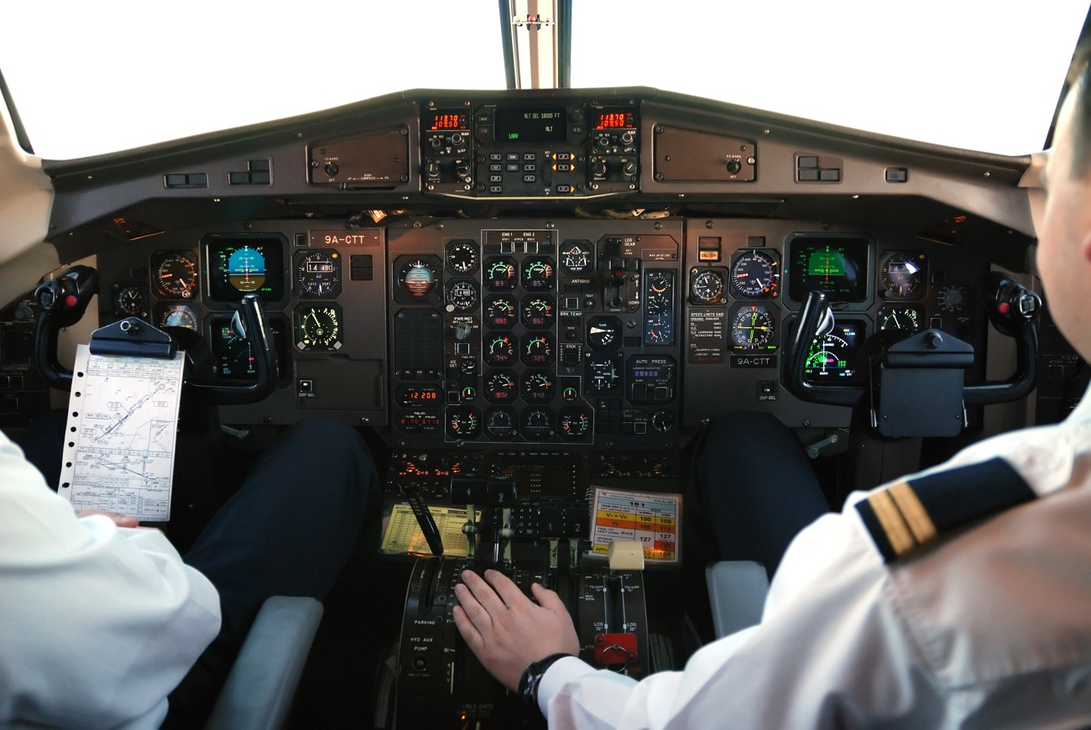
Even experienced pilots use checklists...

Slide 24
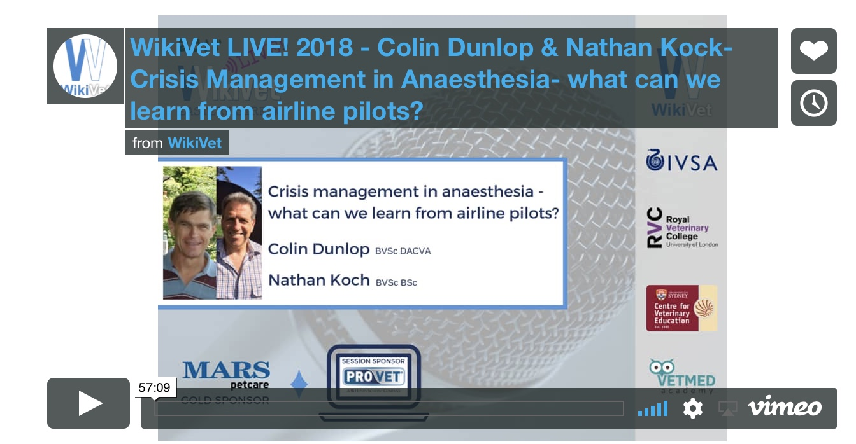
https://www.wikivetlive.com/crisis-management-in-anaesthesia

Slide 25
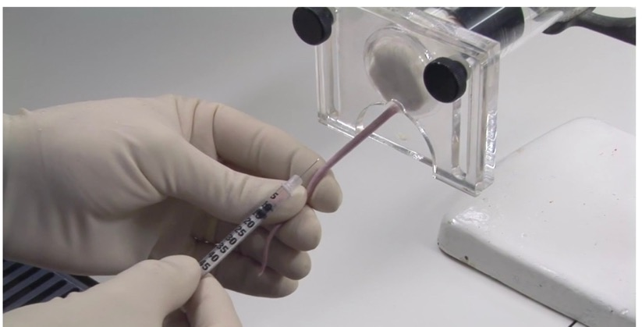
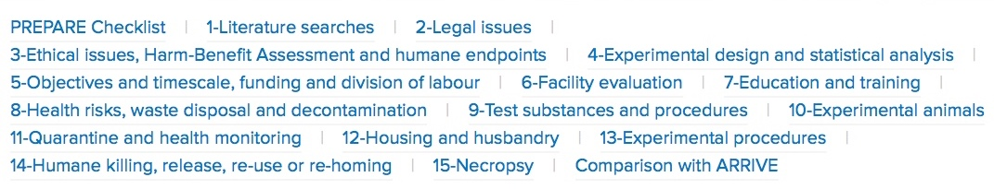
An example: i.v. injection of a radioactive isotope:
norecopa.no/PREPARE
procedureswithcare.org.uk/intravenous-injection-in-the-mouse

Slide 26
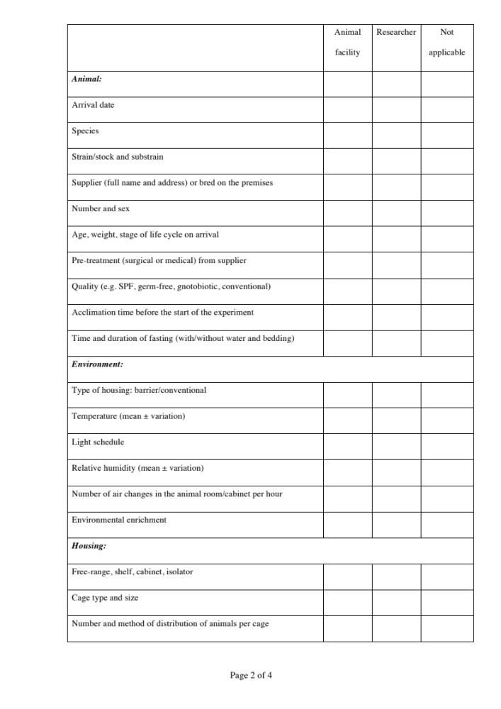
Contract between the animal facility and the research group
The division of labour and responsibilities between the two parties, with the aim of clarifying all stages of the experiment and ensuring that all necessary parameters are recorded.

Slide 27
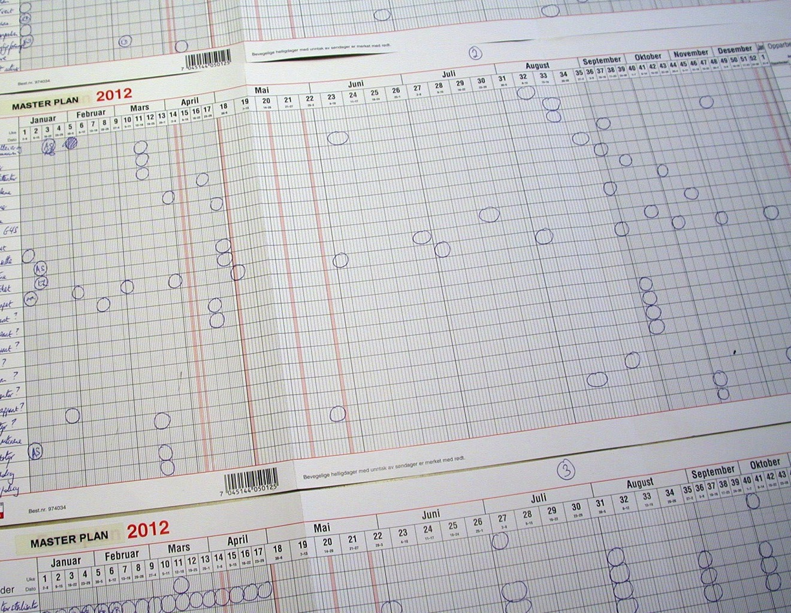
A simple but effective Master Plan

Slide 28



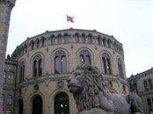






Thanks to our main sponsors:
Standing Committee on Business Affairs, Norwegian Parliament
Norwegian Ministries of Agriculture and Fisheries
Research Council of Norway
Laboratory Animals Ltd.
Nordic Society Against Painful Experiments (NSMSD)
Norwegian Society for Protection of Animals (Dyrebeskyttelsen Norge)
Novo Nordisk
Scottish Accreditation Board
Stiansen Foundation
Universities Federation for Animal Welfare (UFAW)
US Department of Agriculture, Animal Welfare Information Center (AWIC)
Graphics: colourbox.com

Slide 29
May I ask you for a favour?
If you have found this presentation interesting, please spread information about Norecopa and our resources to your colleagues, at home and abroad.
norecopa.no
If you would like to translate this presentation into your native language, you will find the commentary as a Word file and the slides as a Powerpoint file on the PREPARE website: norecopa.no/PREPARE
Thank you for listening!

