Slide 1
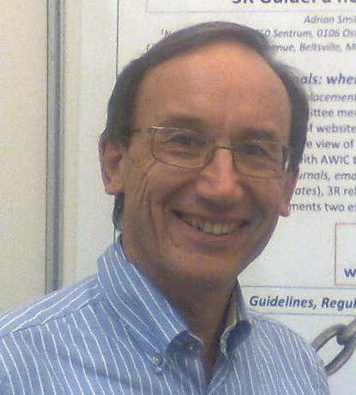

The Norecopa website norecopa.no:
what’s in it for me?
norecopa.no/info
Adrian Smith, Secretary
adrian.smith@norecopa.no
norecopa.no

Slide 2

Norecopa
Norway’s National Consensus Platform for the Replacement, Reduction and Refinement of Animal Experiments

Slide 3

European Consensus-Platform for Alternatives
ecopa.eu
Recognises National Consensus Platforms (NCPs) with 4 stakeholders equally represented:
Government
Research
Industry
Animal
welfare

Slide 4
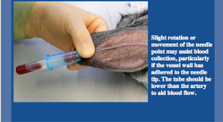
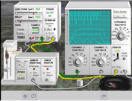
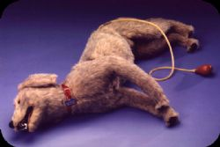
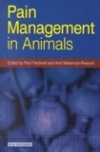

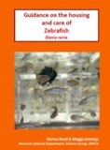
Confused by all the names?
NORINA – established 1991
TextBase
3R Guide
Classic AVs
Oslovet
Guidelines, databases, information centres etc.
A subset of NORINA (items using old technology)
norecopa.no/NORINA
Oslo Veterinary School
One site to unite them all: Norecopa.no – established 2007
Zero tolerance of dead links (404-errors)
Do I have to make new bookmarks for your webpages? No!

Slide 5
norecopa.no
One (intelligent) search engine for everything – you no longer a need to know the names of the databases
over 7,500 webpages
80,000 references
22,000 unique links
approx. 160,000 pageviews / year

Slide 6
Responsive and printer-friendly – works equally well on mobile phones, tablets and desktop computers
Hand-picked material for quality and relevance to Laboratory Animal Science, 3Rs and welfare – based on 30 years of experience and networking in the field
Designed to be an answer to the conclusion of so many presentations at congresses: “we need guidelines”!

Slide 7
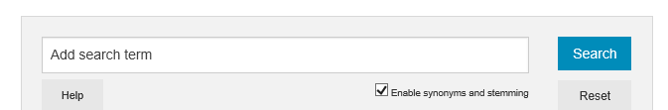
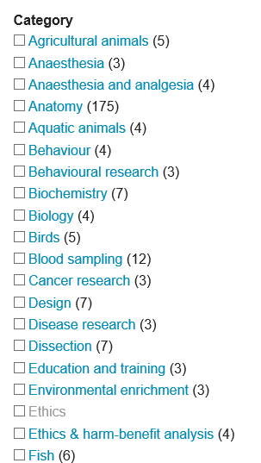
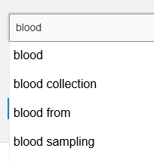
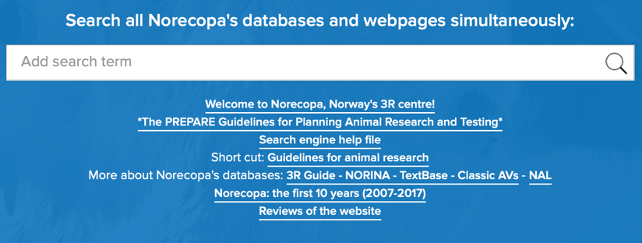
The search engine
Guidelines bleeding mice
Auto-complete function:
Synonym list:
Bleeding, bloodsampling, blood sampling, venepuncture,
blood collection, phlebotomy
      A help file is available:
Advanced algorithms using Fuzzy Logic and Boolean Logic
Supports wildcards, proximity searches and truncation

Slide 8
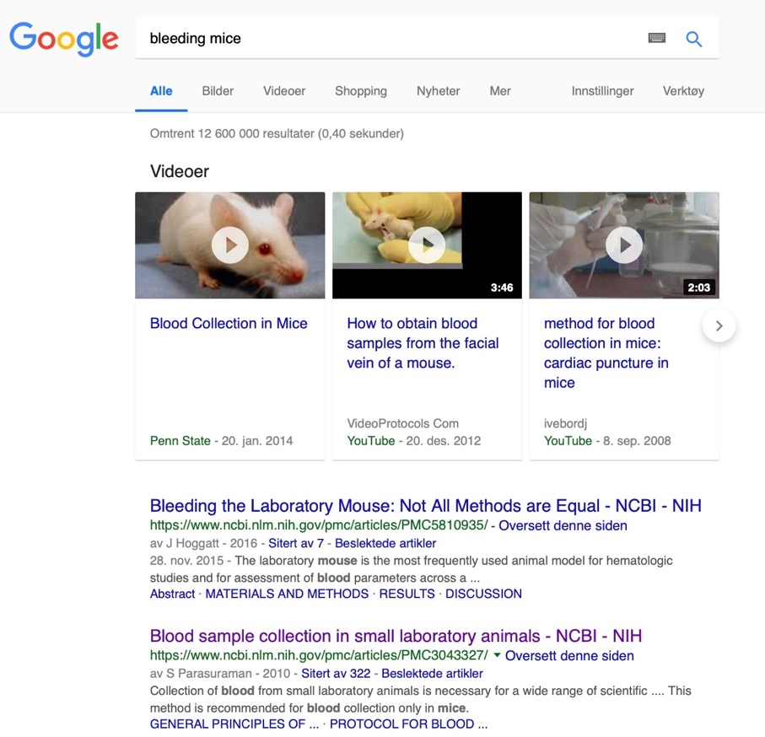
Search for ‘bleeding mice’ on Google and Norecopa.

Slide 9
‘Bleeding’ not mentioned, but identified by the synonym list

Slide 10
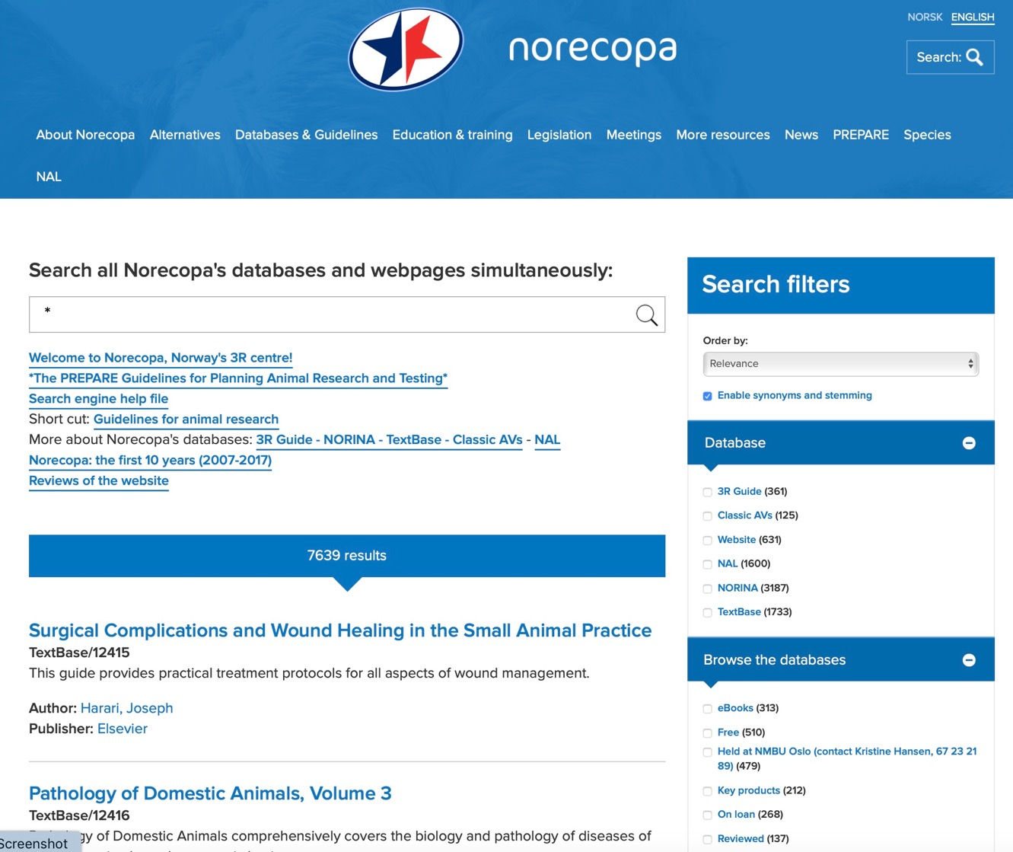


Slide 12
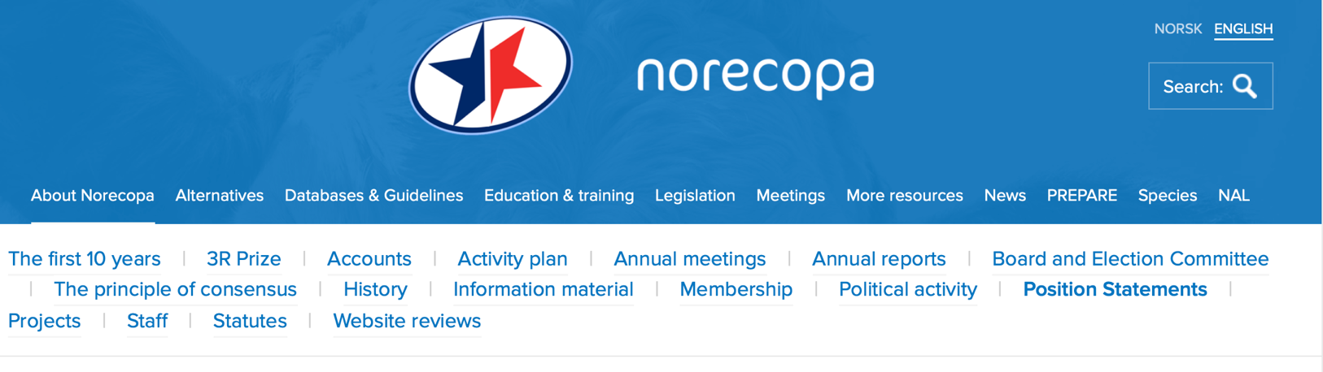

Lectures by international experts
Position statements,
e.g. toe clipping, food deprivation

Slide 13
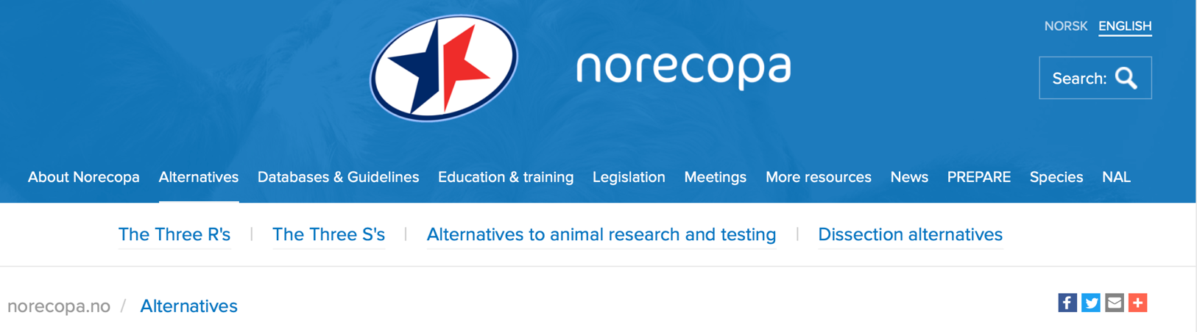
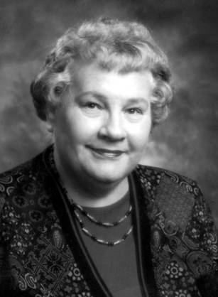
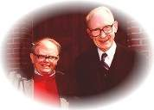
  The three R’s
  Replace
  Reduce
  Refine
  The three S’s
  Good Science
  Good Sense
  Good Sensibilities
William Russell & Rex Burch
photo: UFAW
Carol Newton
photo: National Library of Medicine

Slide 14
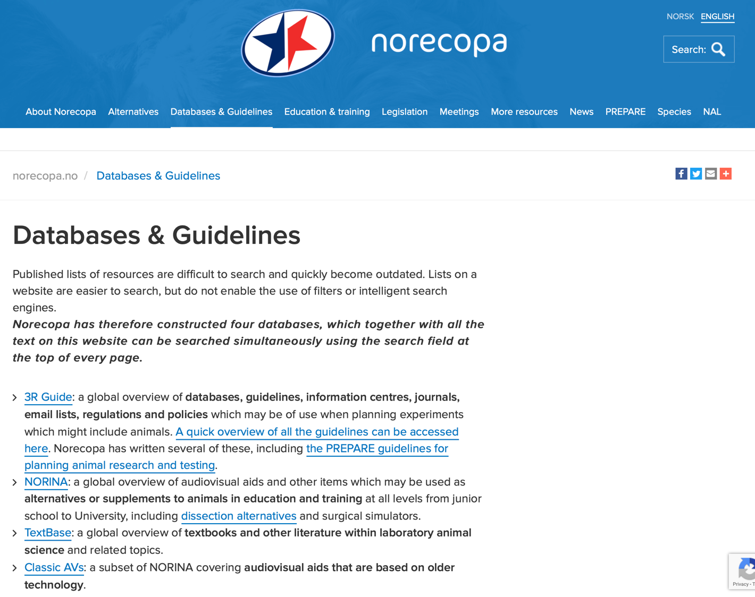

Slide 15
NORINA
approx. 3,100 entries
https://norecopa.no/norina

Slide 16
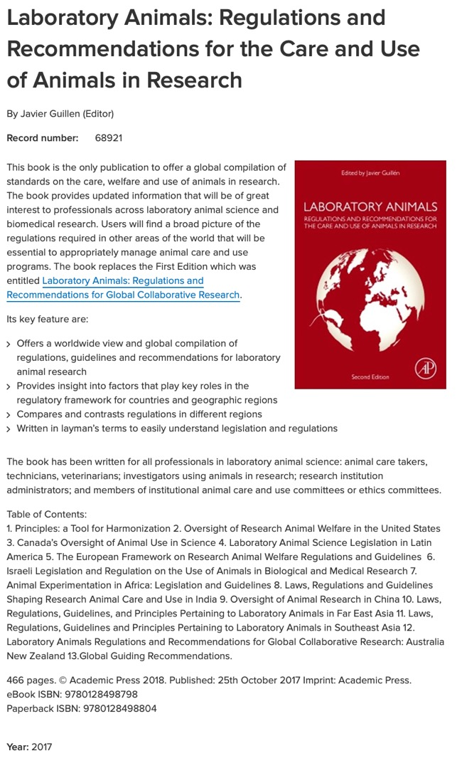
TextBase
approx. 1,700 entries
https://norecopa.no/textbase

Slide 17
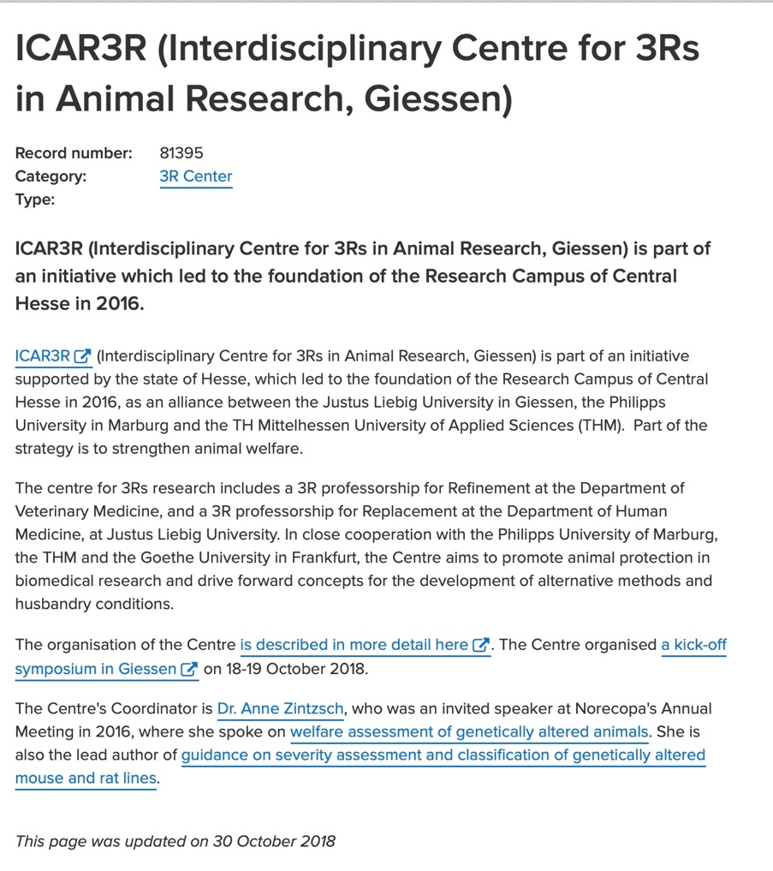
3R Guide
approx. 400 entries
https://norecopa.no/3r-guide

Slide 18
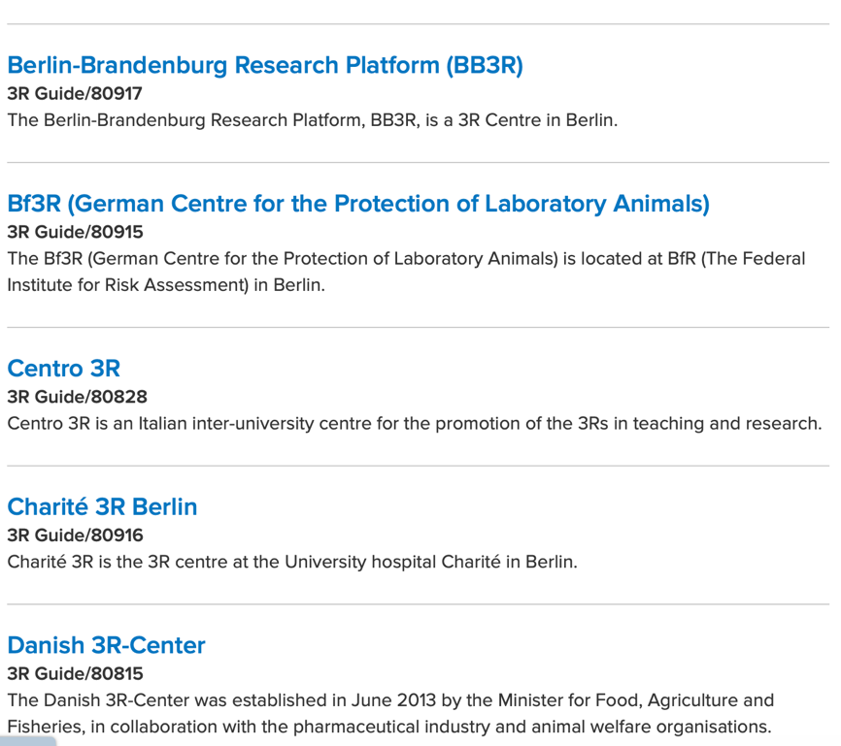
Overview of European 3R Centres
http://bit.ly/2P4dxZJ
3R Guide
approx. 400 entries
https://norecopa.no/3r-guide

Slide 19
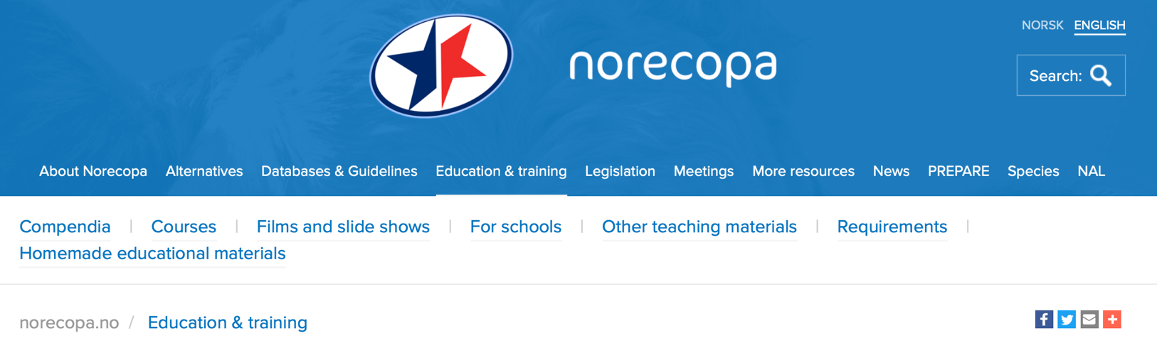
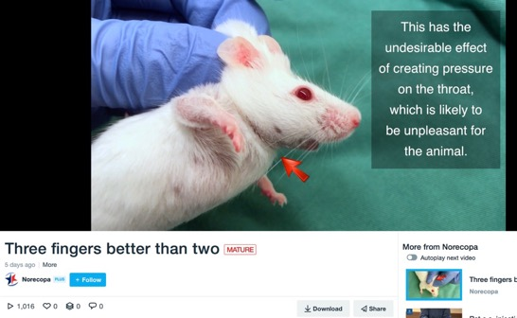
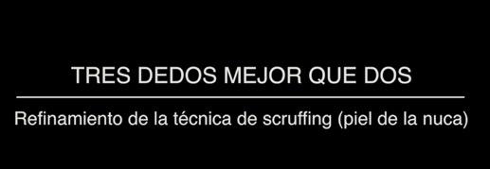
http://bitly.com/scruff-technique

Slide 20
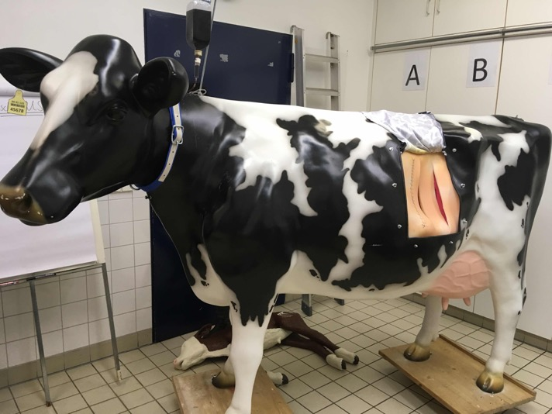
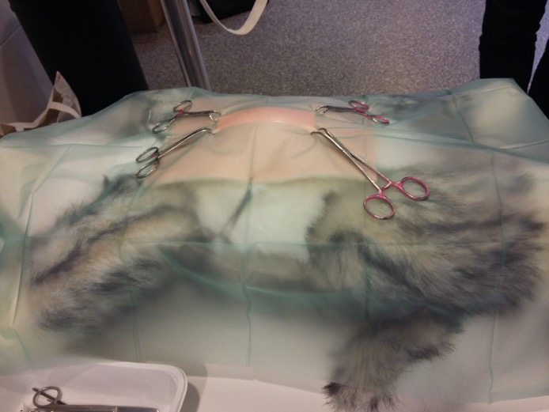
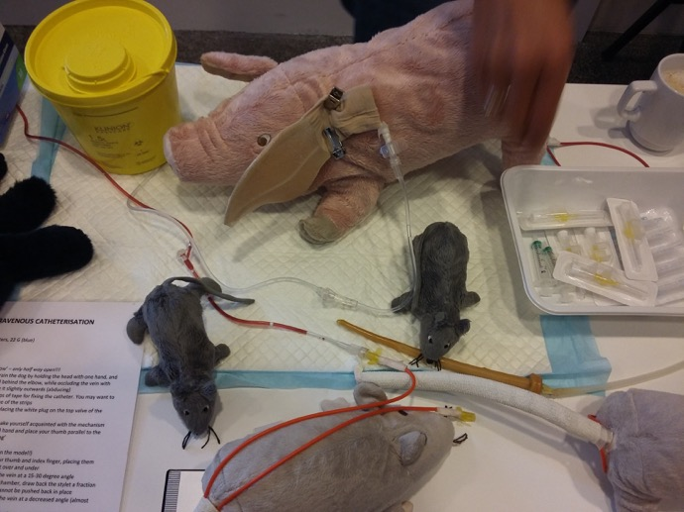
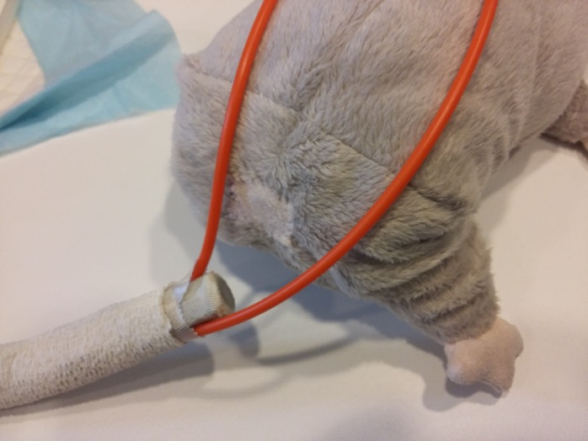
Laura-Kim Schüller, Veterinary School, Berlin
Rikke Langebæk, University of Copenhagen
norecopa.no/education-training/homemade-educational-materials

Slide 21
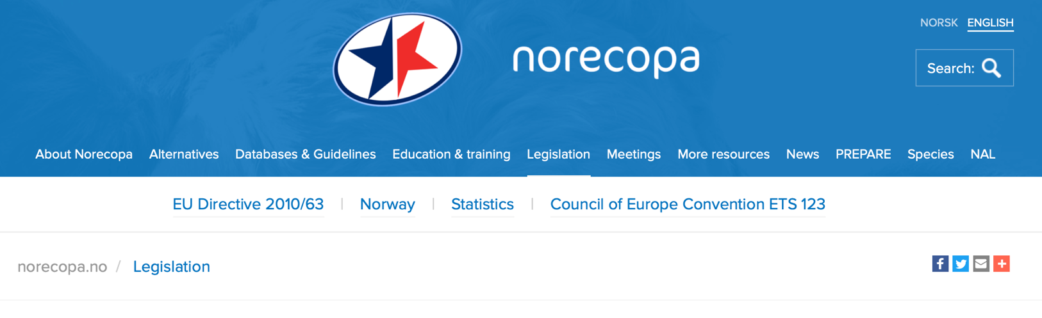

Slide 22
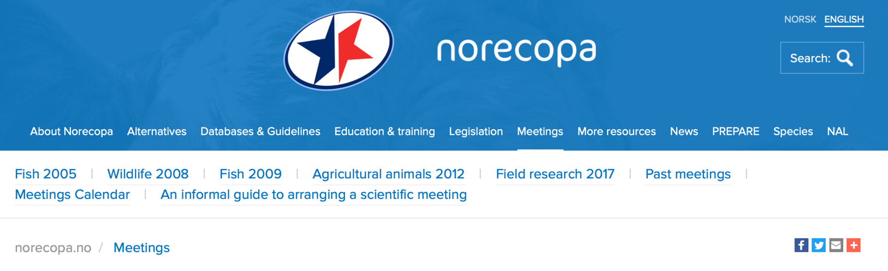
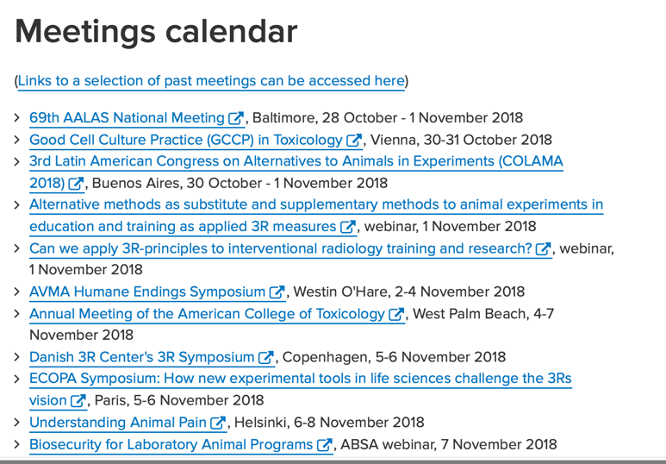
All the presentations are on the internet: a lasting resource

Slide 23
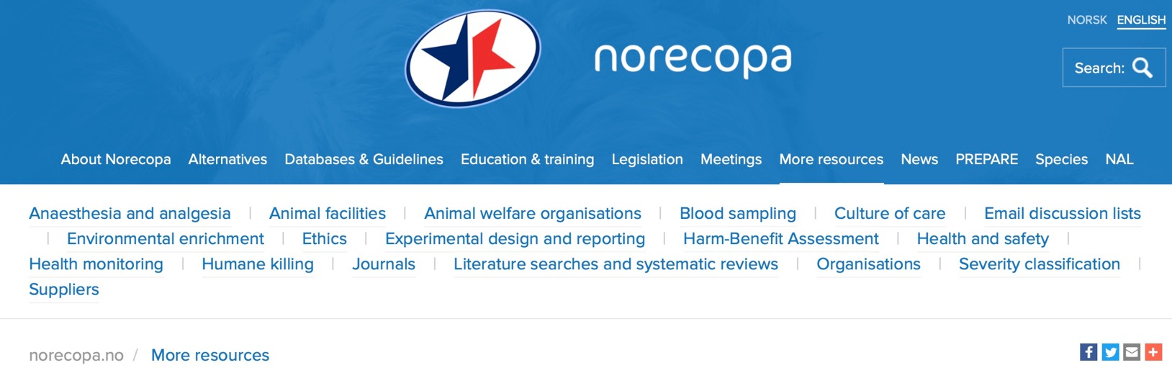

Slide 24
Alice Tillema, Radboud University:
How to construct a literature search
http://norecopa.no/how-to-construct-a-literature-search.pdf

Slide 25
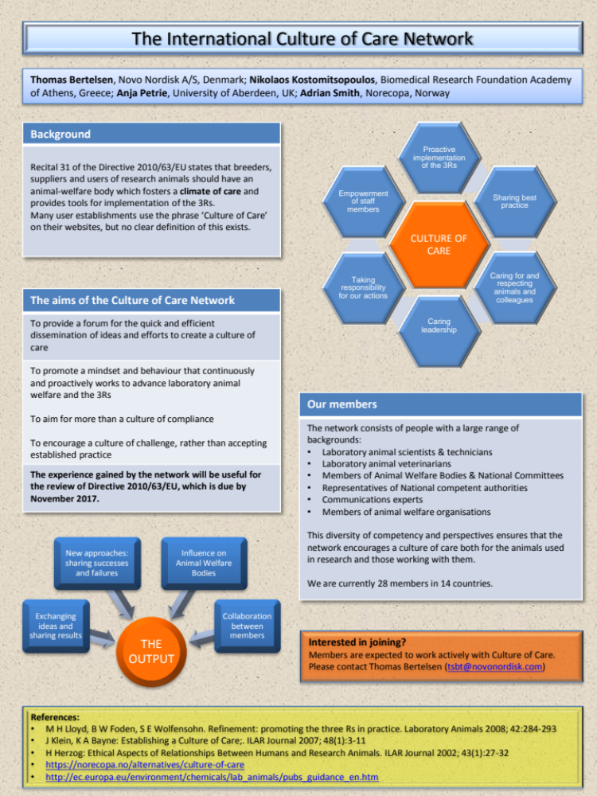
The International Culture of Care Network
norecopa.no/culture-of-care
35 members from user establishments, competent authorities, communication and interest organisations, in 16 countries
Proposed by Thomas Bertelsen at the FELASA Congress in Brussels in June 2016, where there were 7 presentations which discussed the culture of care. To share and publish examples of activities fostering a Culture of Care which improve animal welfare.

Slide 26

Guidance on the severity classification of procedures involving fish
Report from a Working Group
convened by Norecopa
P Hawkins, N Dennison, G Goodman, S Hetherington,
S Llywelyn-Jones, K Ryder and AJ Smith
Laboratory Animals, 45: 219-224, 2011
norecopa.no/categories

Slide 27
Expert Working Group report on severity classification
http://ec.europa.eu/environment/chemicals/lab_animals/pdf/report_ewg.pdf

Slide 28
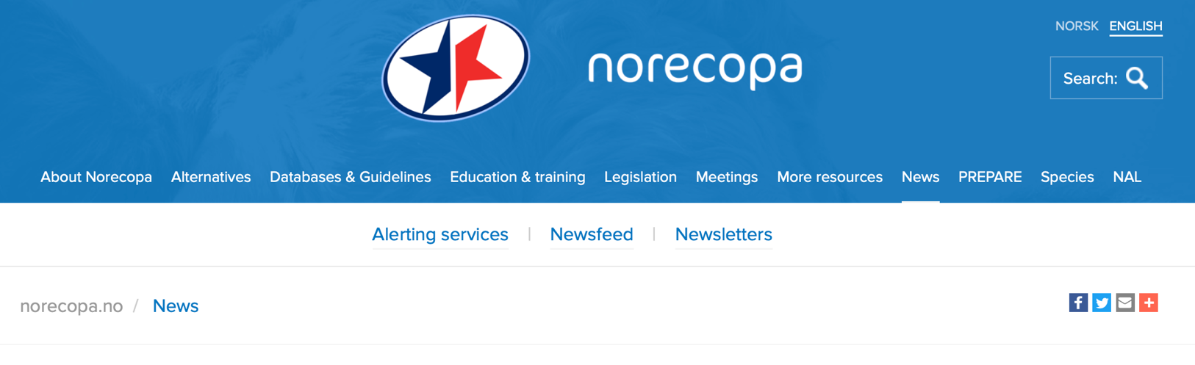
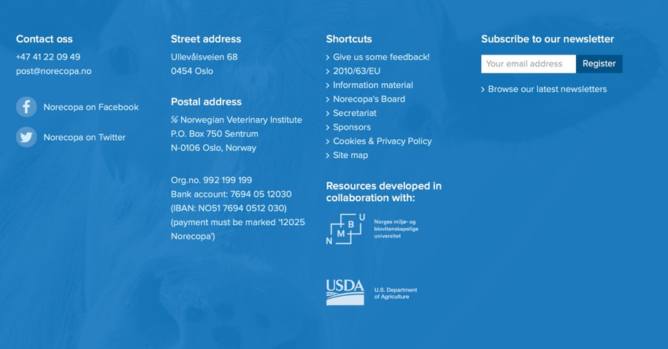
Newsletter 7-8 times a year
something for you?
searchable archive of all
norecopa.no/news

Slide 29
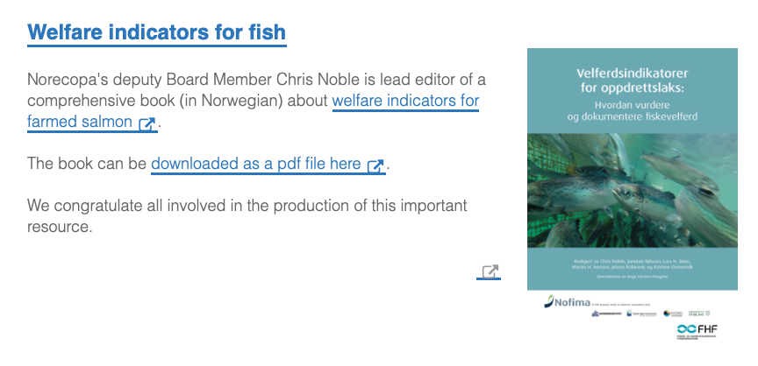
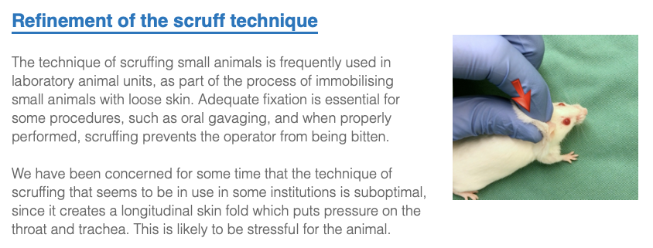
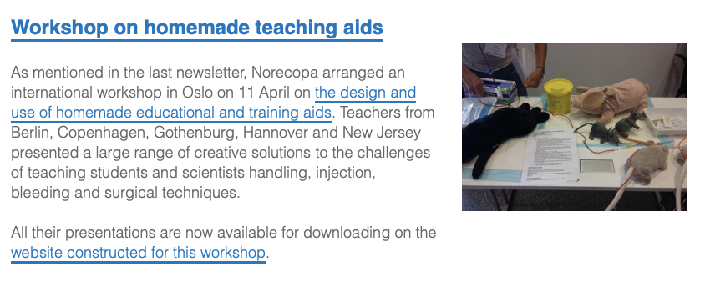
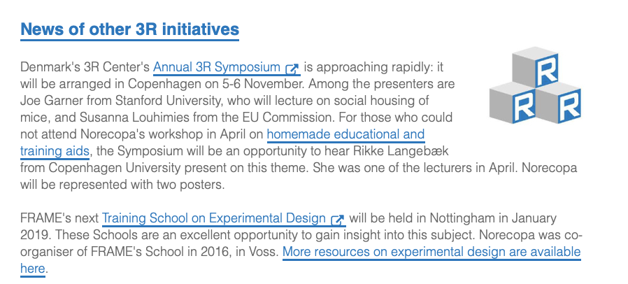
Newsletter 7-8 times a year norecopa.no/news
3R initiatives worldwide
Update on Norecopa’s work
News from 3R research
Food for thought

Slide 30
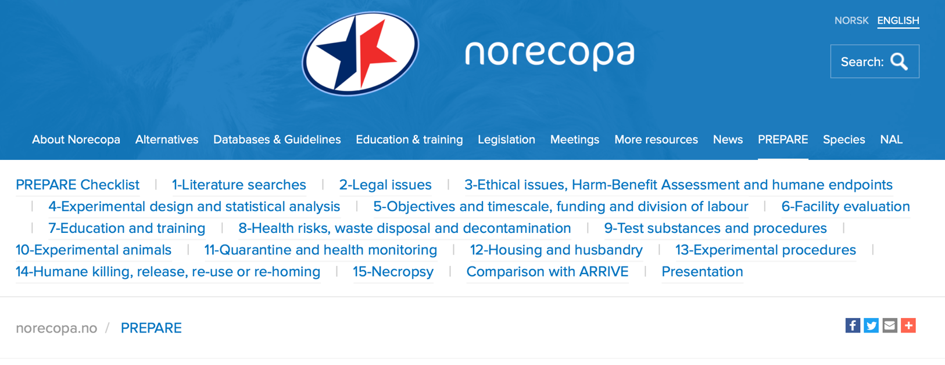
Video: https://norecopa.no/PREPARE

Slide 31
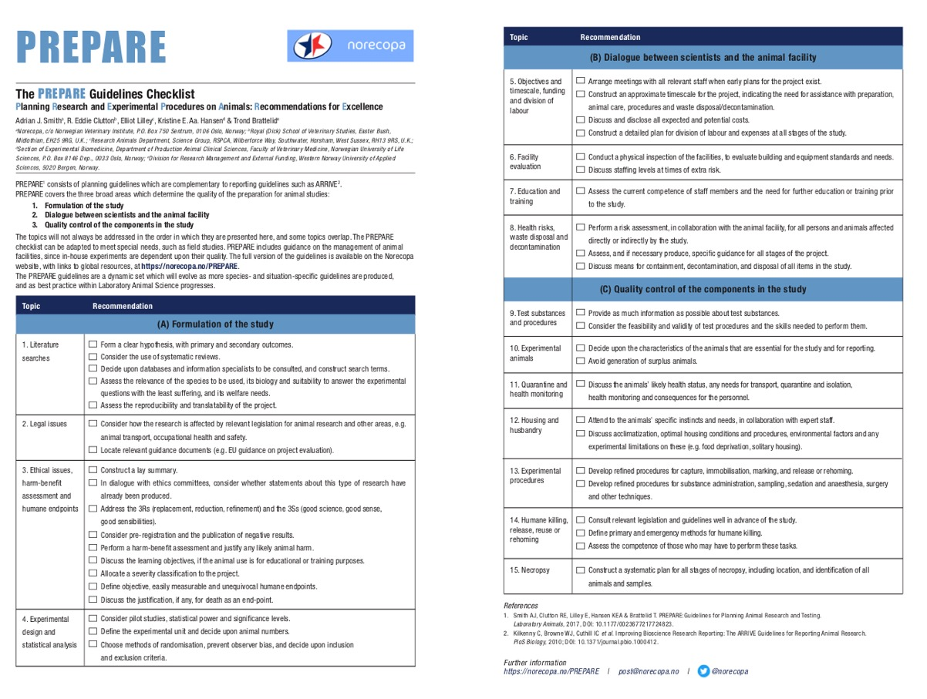
Two pages, translated into 16 languages so far

Slide 32
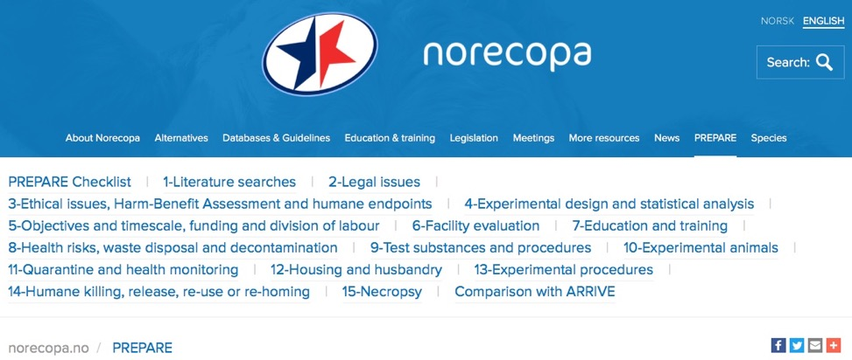
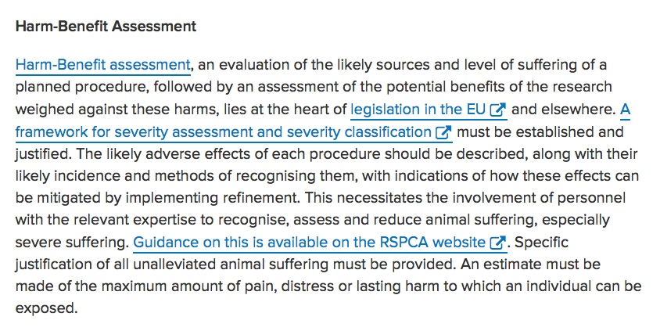
norecopa.no/PREPARE
Links to quality guidelines worldwide on e.g. housing and husbandry, injection volumes, blood sampling, anaesthesia and analgesia, humane endpoints, experimental design

Slide 33
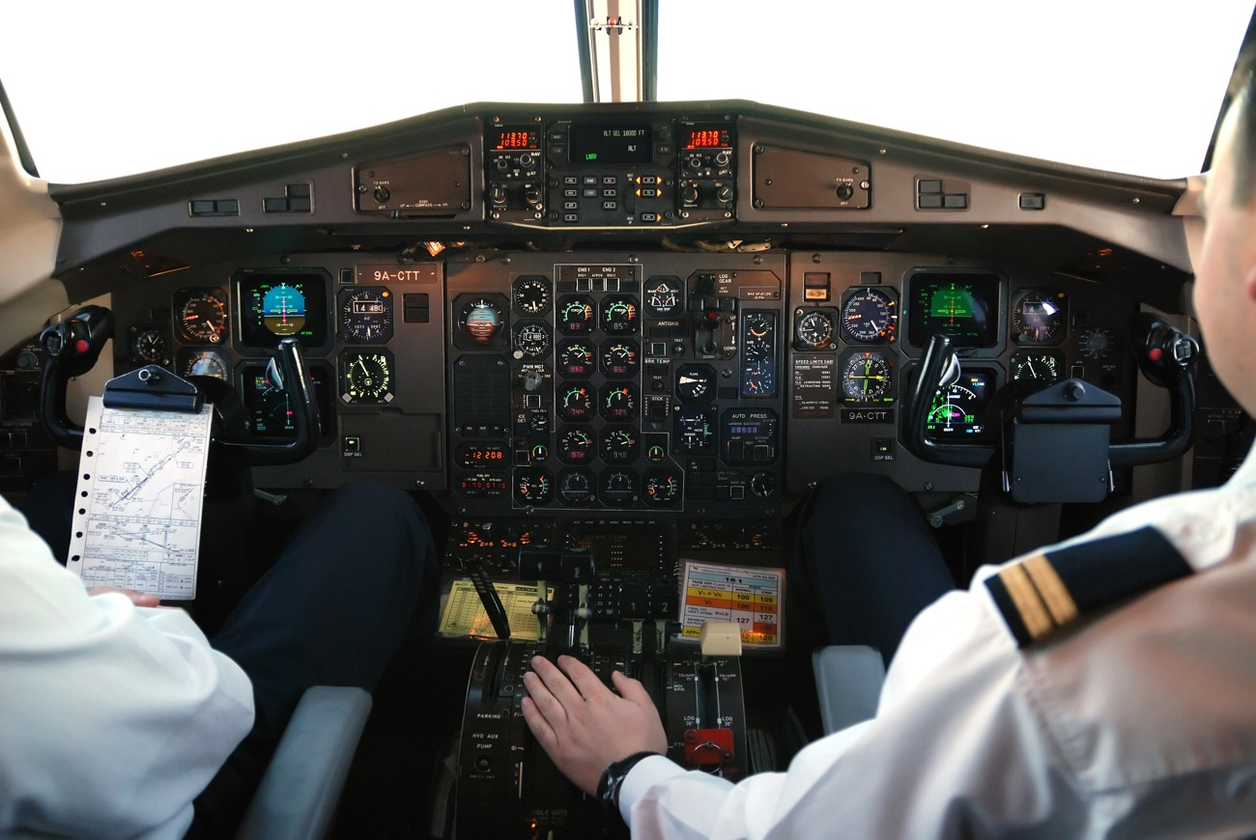
Even experienced pilots use checklists...
Presentation of PREPARE on
norecopa.no/PREPARE

Slide 34
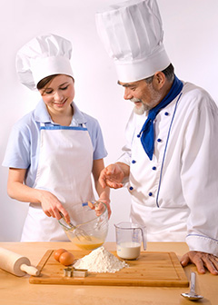
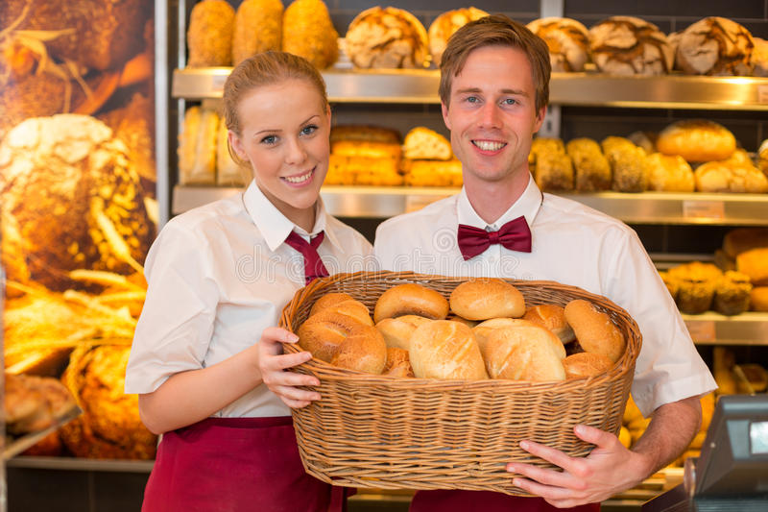
PREPARE
ARRIVE
https://www.bls.gov/ooh/images/3077.jpg
https://www.dreamstime.com

Slide 35
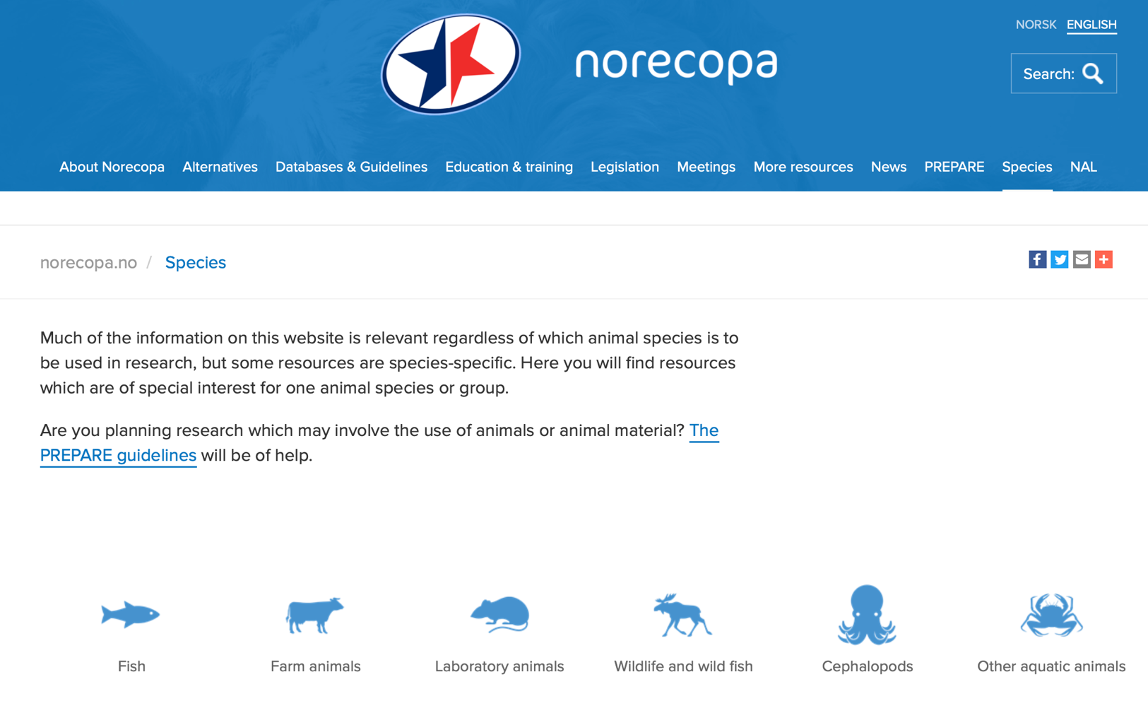

Slide 36
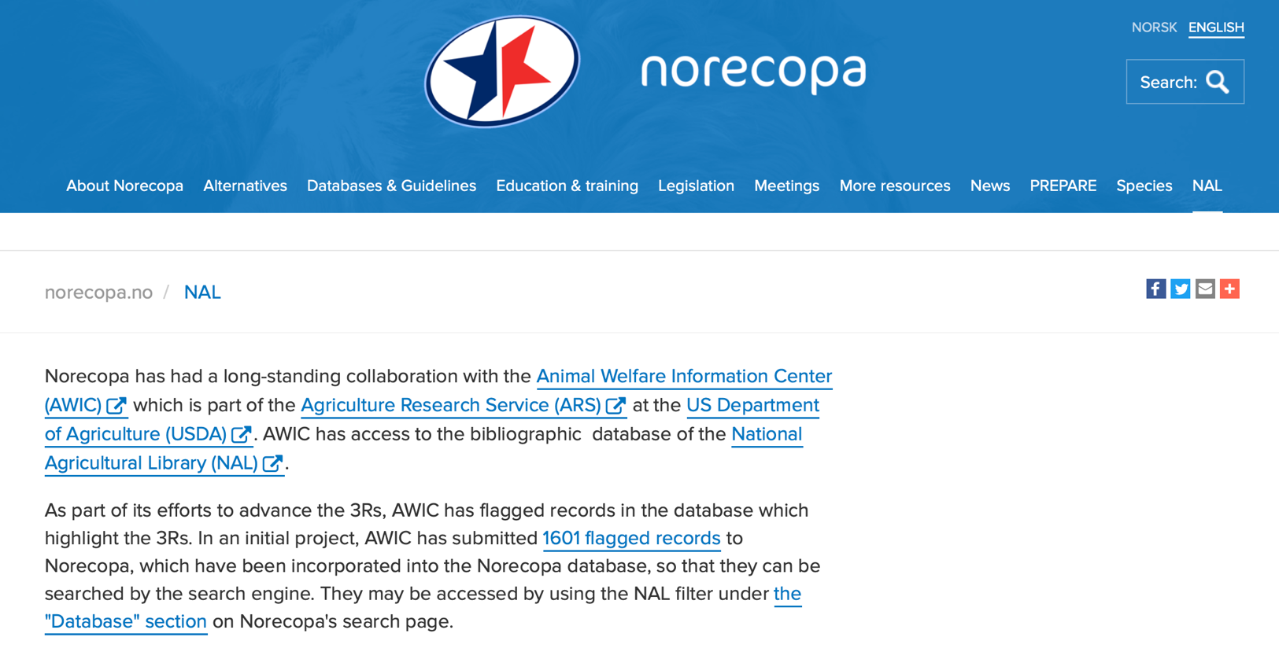

Slide 37


or follow the breadcrumbs:
Site map
norecopa.no/info

Slide 38
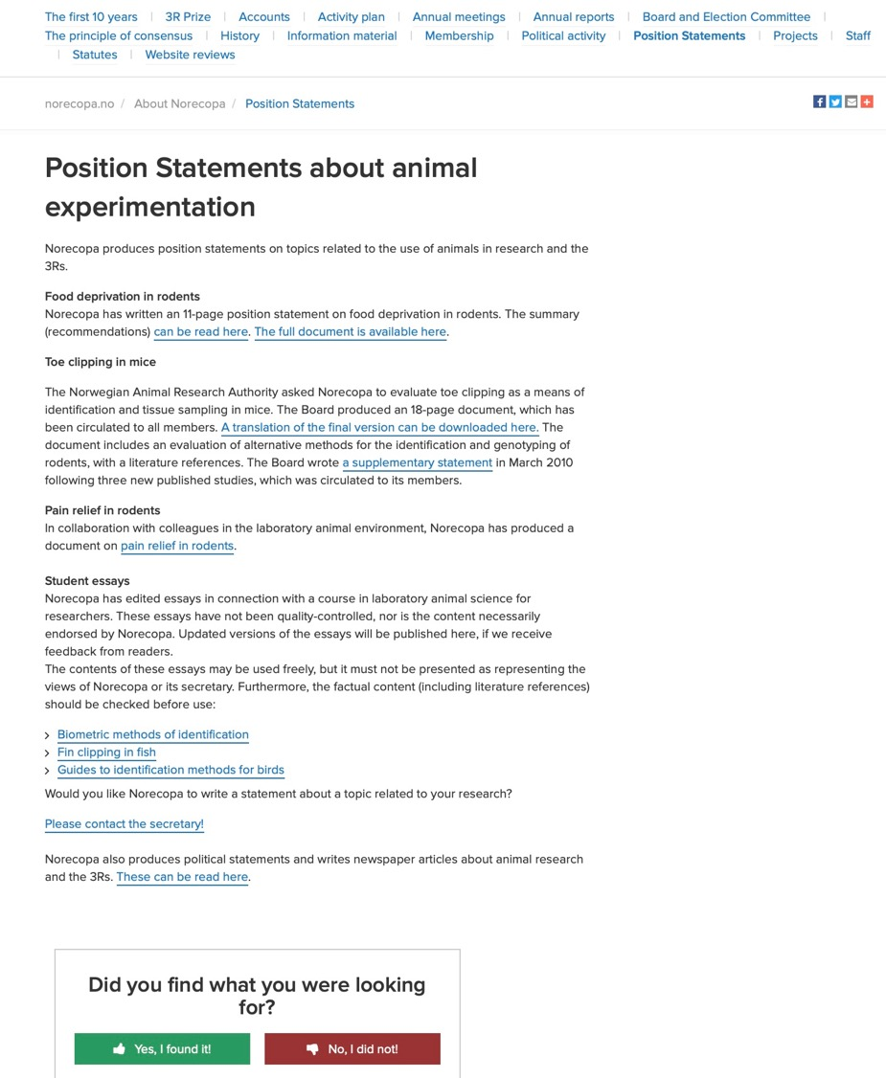

Slide 39

adrian.smith@norecopa.no

Slide 40


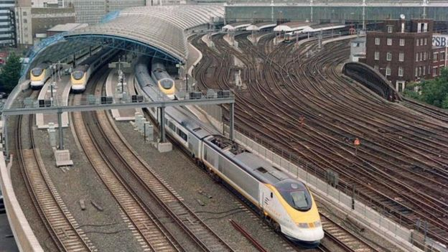




Our vision:
To aid dissemination of 3R resources between the different scientific fields
There are lots of platforms...
Norecopa aims to be a fast train to global 3R resources
https://kmonadollaraday.files.wordpress.com/2011/03/information-silos.jpg
http://www.london-gifts.co.uk
Photo: http://www.bbc.com/news/uk-england-london-35882068

Slide 41



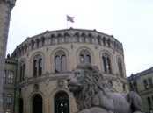






Thanks to our main sponsors:
Standing Committee on Business Affairs, Norwegian Parliament
Norwegian Ministries of Agriculture and Fisheries
Research Council of Norway
Laboratory Animals Ltd.
Nordic Society Against Painful Experiments (NSMSD)
Norwegian Society for Protection of Animals (Dyrebeskyttelsen Norge)
Novo Nordisk
Scottish Accreditation Board
Stiansen Foundation
Universities Federation for Animal Welfare (UFAW)
US Department of Agriculture, Animal Welfare Information Center (AWIC)
Graphics: colourbox.com

Slide 42
May I ask you for a favour?
If you have found this presentation useful, please spread information about Norecopa and our resources to your colleagues, at home and abroad.
norecopa.no
If you would like to translate this presentation into your native language, you will find the commentary as a Word file and the slides as a Powerpoint file on the Norecopa website: norecopa.no/info
Thank you for listening!

